Slide 1

Knight Bites
Aayam Shrestha
Anjana Sainju
Charles Duimstra
Ifeanyi Onyeanakwe

Slide 2
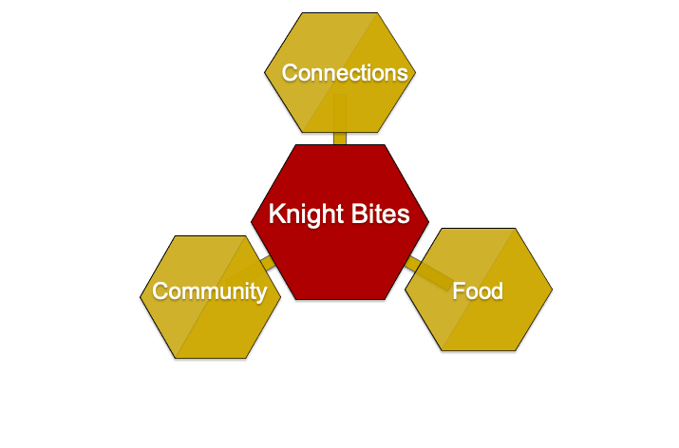
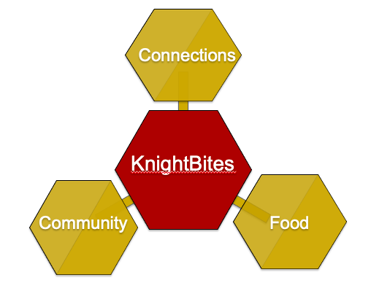
Our Vision
KnightBites

Slide 3
Demo

Slide 4
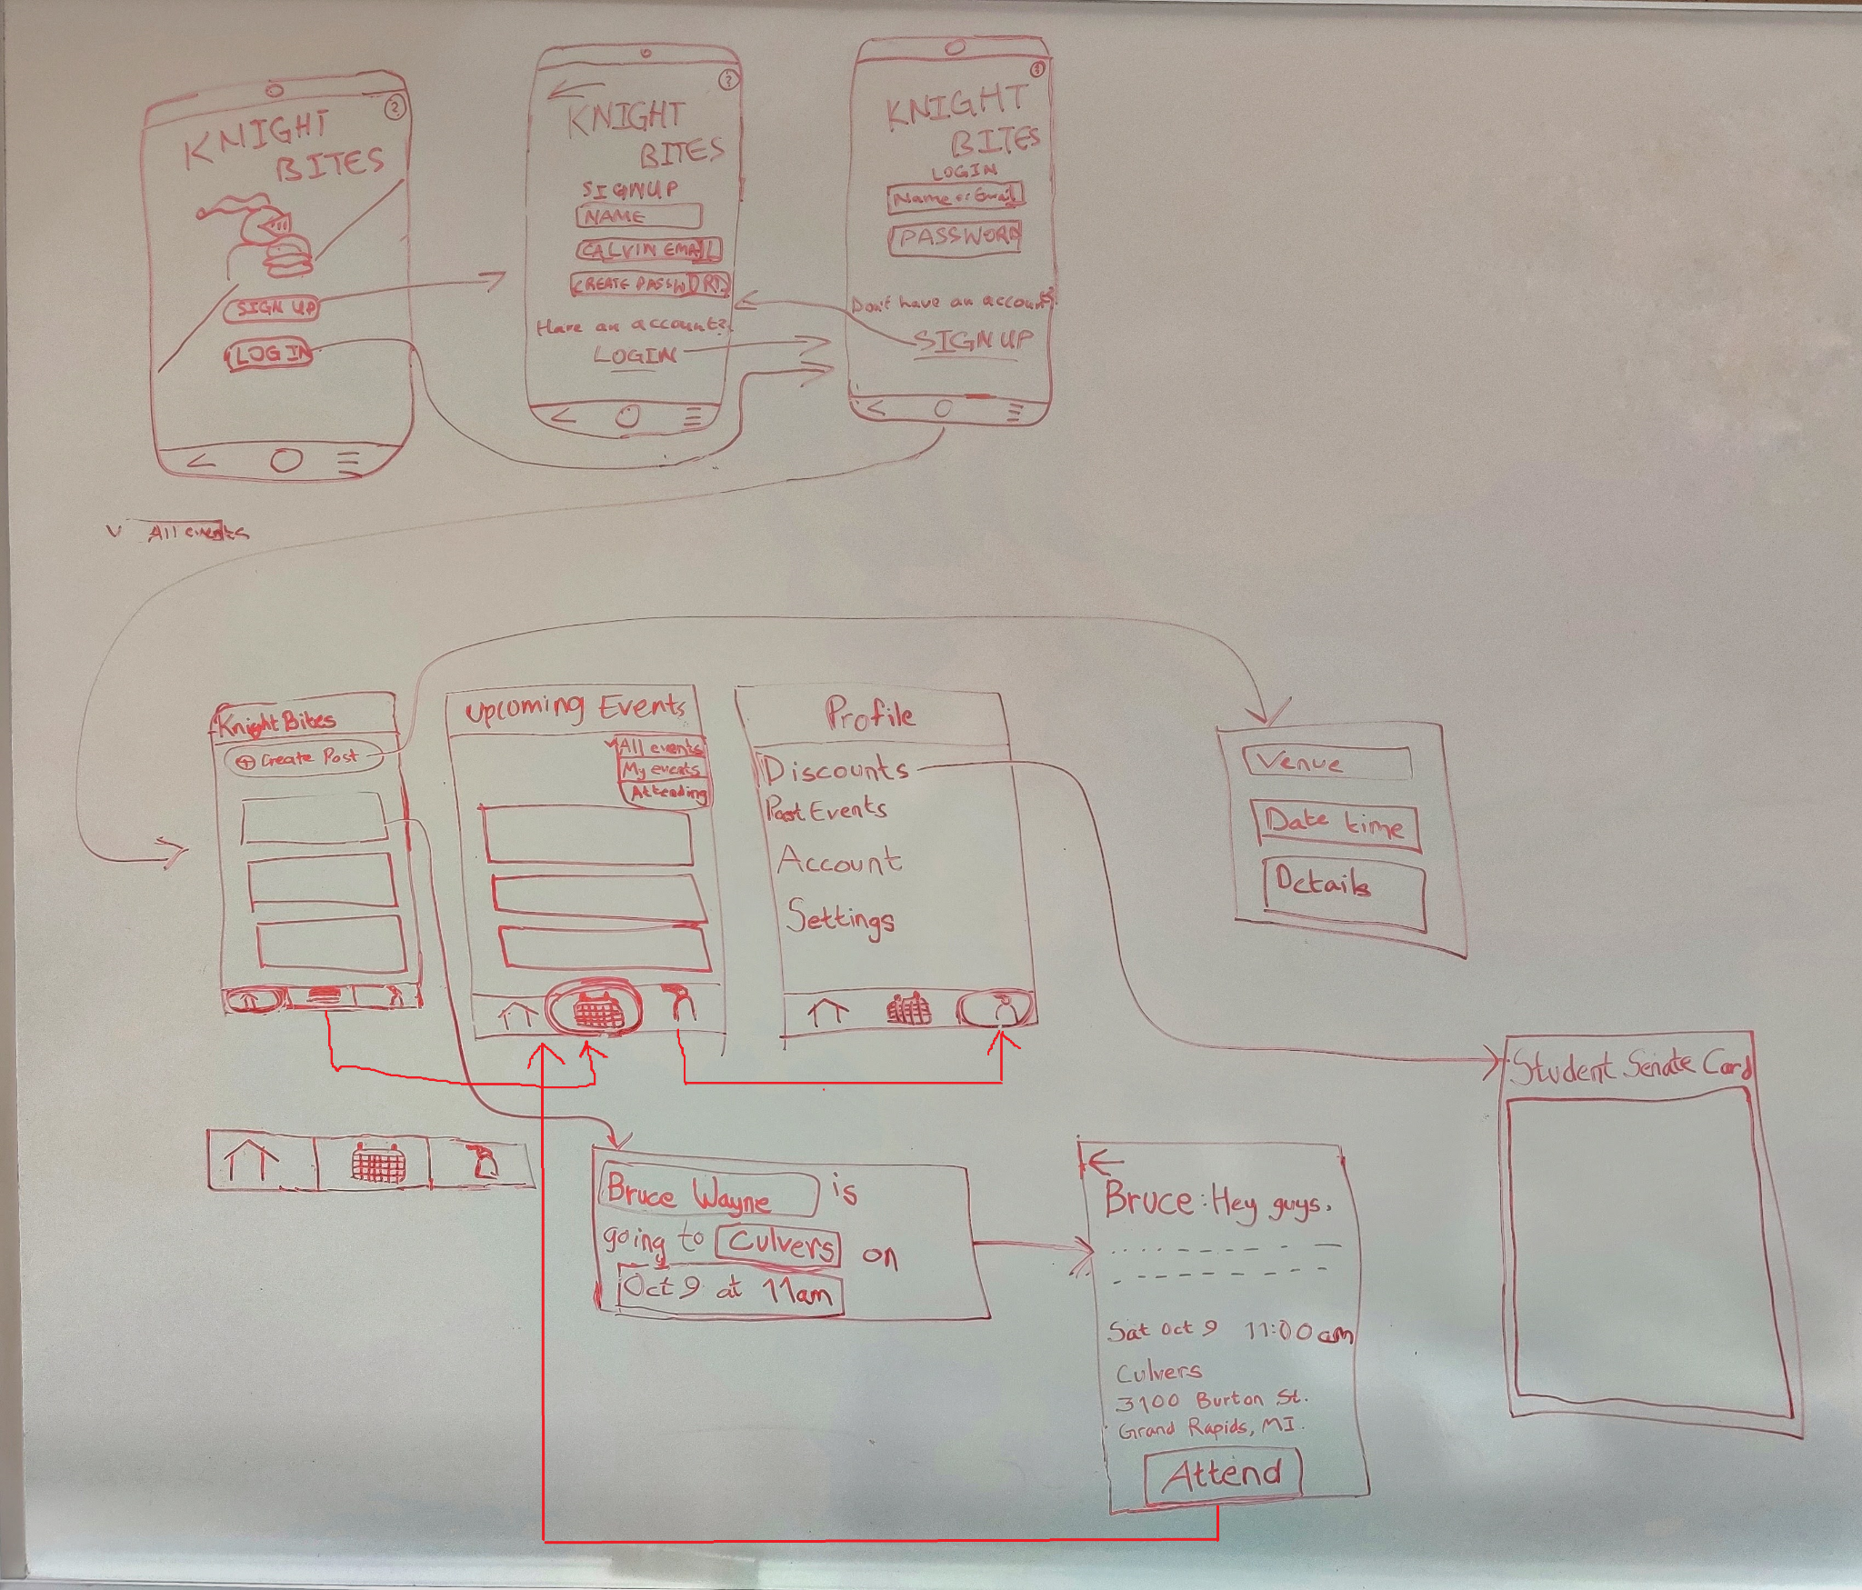
UI Mockup

Slide 5
UI Mockup

Slide 6
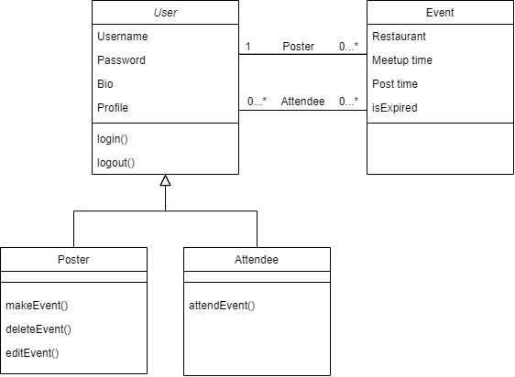
Domain Model
picture

Slide 7
Database Schema
Student(email, firstName, lastName, bio)
Restaurant(name, address, openingTime, closingTime, priceRange, discount)
Post(studentEmail, restaurantName, restaurantAddress, postTime, meetupTime)

Slide 8
Status Report
Posts and Comments
Profiles
Metadata
Ease of Use

Slide 9
Questions?

